Slide 1

INSTITUTE :UIE
DEPARTMENT: ALL ACADEMIC UNITS
Bachelor of Engineering (All Sections)
Subject Name and Code:
Engineering Physics 23SPH-141
Prepared by: Anu Kapoor, Assistant Prof. Physics
LASER
DISCOVER . LEARN . EMPOWER

Slide 2
COURSE OBJECTIVES
The course is designed to make the students industry ready to contribute in the growing demand of the industry at local, national and international level.
It will make the students competent to understand basic concepts and applications of advanced engineering physics and apply its principles in their respective fields at global platform.
It will enhance the skill level of the students and shall make them preferred choice for getting employment in industry and research labs.
It will give thorough knowledge of the discipline to enable students to disseminate knowledge in pursuing excellence in academic areas.

Slide 3
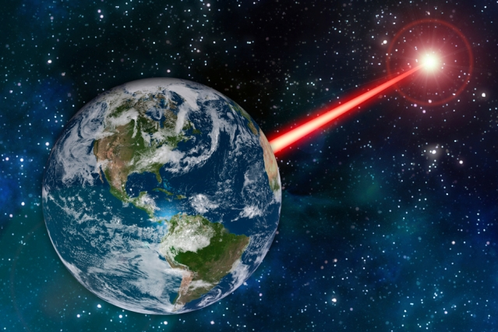
COURSE OUTCOMES
CO Number | Title On completion of this course, the students are expected to learn | Level
CO1 | Quote the basic fundamental concepts of lasers, optical fibres, crystallography, ultrasonic oscillations, semiconductor physics, quantum mechanics and nanotechnology. | Remember, Understand
CO2 | Demonstrate the working of various lasers, fibre components, semiconductor devices; explain the behaviour of crystalline solids, quantum and nano-scale systems. | Understand
CO3 | Solve problems by applying principles related to lasers, fibres, semiconductors, oscillations, quantum and nanoscience. | Applying
CO4 | Compare various lasers and fibres, semiconducting devices, crystalline materials, structures at quantum and nanoscale on the basis of their properties for industrial applications. | Analyze
CO5 | Develop various systems using lasers, fibres, semiconductors and nanomaterials for futuristic applications. | Design
Fig. 1 Introduction [1]

Slide 4

“ In the War of Worlds, written before the turn of 20th century, HG Wells told a fanciful story of how Martians invaded and almost conquered the earth. Their weapon was a mysterious sword of heat, from which flickered a ghost of a beam of light. It felled men in their tracks, made lead run like water and flashed anything combustible into masses of flame. Today Well’s word of heat comes close to reality in the laser…………”
Fig. 2 Introduction [2]

Slide 5

WHY TO STUDY LASER
Offering a high-speed way to process various materials, lasers are being used on a large scale in various industries.
Innovative technologies are driving the growth of industrial lasers. Manufacturers are introducing technologically advanced industrial lasers for various applications.
The global industrial laser market is highly dynamic, and growing at a fast pace.
The increasing innovations taking place in fiber lasers play an important role in the growth of the global industrial laser market
https://www.youtube.com/watch?v=_yLfLDHBUak [3]

Slide 6

CONTENT TO BE DISCUSSED….
Introduction to LASERS
Properties of Laser
Quantum Processes
Fig. 3 Introduction [4]

Slide 7
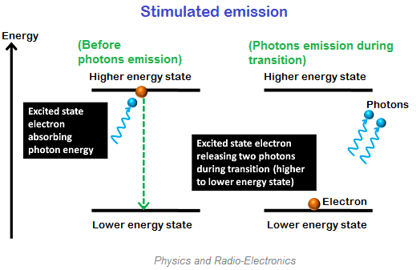
LASER EMISSION
L –Light
A – Amplification by
S – Stimulated
E – Emission of
R – Radiation
Stimulated Emission is the key to the laser action
Fig. 4 Stimulated emission [5]

Slide 8
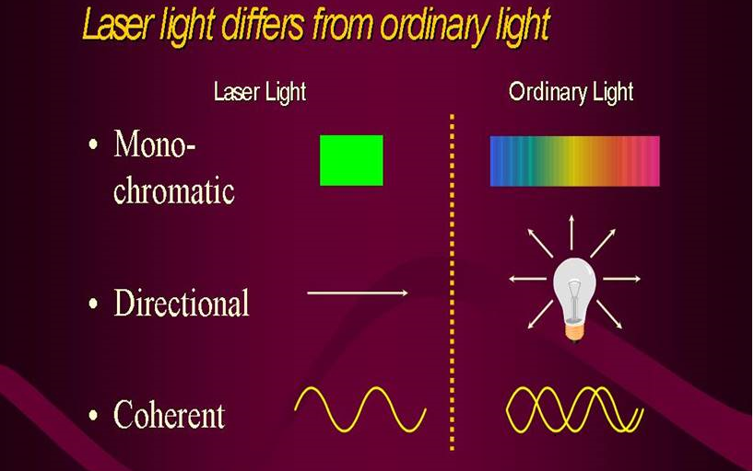
SPECIAL PROPERTIES OF LASER
Monochromatic
Unidirectional
Coherent
Narrow band width
High Intensity
Fig. 5 difference between laser and ordinary beam[6]

Slide 9

COHERENCE
Coherence is very important property of Laser.
First let us understand the difference between coherent and incoherent light….
Incoherent Light: The light emitted from the Sun or other ordinary light sources such as tungsten filament and fluorescent tube lights is spread over a wide range of frequencies.
Incoherent light is due to spontaneous and random emission of photons by the atoms in excited state. These photons will not be in phase with each other.
Fig. 6 Incoherent light

Slide 10

COHERENCE
Coherent Light:
Coherent light is uniform in frequency, amplitude, continuity and constant initial phase difference.
Coherent beam of light is obtained due to stimulated emission of photons from the atoms jumping from meta-stable state to lower energy state.
Fig. 8 Coherent light

Slide 11
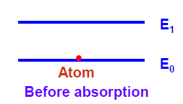
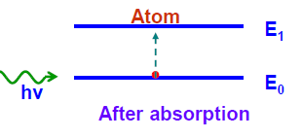

VARIOUS ATOMIC INTERACTIONS RELATED TO LASER
1. Induced Absorption:
Photons of suitable frequency (energy) are supplied to the atoms in the ground state. These atoms absorb the supplied energy and go to the excited or higher energy state. If Ei and Ej are energies of ground state (lower energy) and excited state (higher energy), then the frequency of required photon for absorption is
where h is Planck’s constant

Slide 12
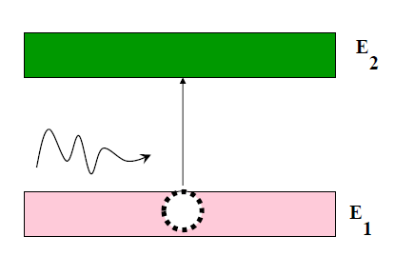


VARIOUS ATOMIC INTERACTIONS RELATED TO LASER
Induced Absorption:
The probability of occurrence of this absorption from state 1 to state 2 is proportional to the energy density u(ν) of the radiation
Where is proportionality constant and is known as Einstein coefficient of absorption of radiation

Slide 13
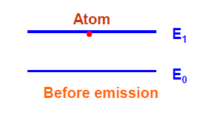
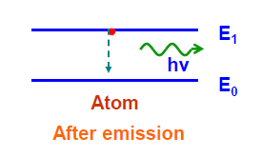
VARIOUS ATOMIC INTERACTIONS RELATED TO LASER
2. Spontaneous Emission:
An excited atom can stay in the higher energy state only for the time of 10-8 s. After this time, it returns back to the lower energy state by emitting a photon
of energy
This emission is called ‘spontaneous emission’. During spontaneous emission, photons are emitted randomly and hence they will not be in phase with each other. Therefore, the beam of light emitted is incoherent.

Slide 14
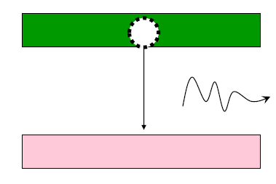


VARIOUS ATOMIC INTERACTIONS RELATED TO LASER
Spontaneous Emission: The probability of occurrence of spontaneous emission transition from state 2 to state 1 depends only on the properties of states 2 and 1 and is given by
where proportionality constant is known as Einstein coefficient of spontaneous emission of radiation.

Slide 15
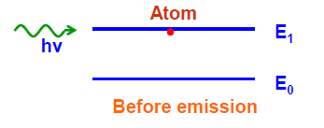
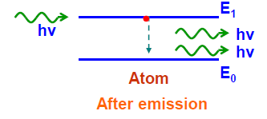
VARIOUS ATOMIC INTERACTIONS RELATED TO LASER
3. Stimulated Emission
When photon of suitable frequency (energy) is made to fall on an excited atom in the higher energy state, the atom falls back to the ground state by emitting a photon of energy which is in phase with the stimulating (incident) photon.
Thus, it results in the appearance of one additional photon. This process is called ‘stimulated or induced emission’.

Slide 16
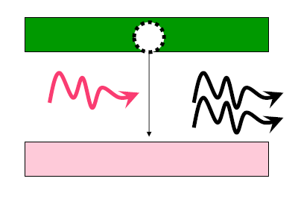


VARIOUS ATOMIC INTERACTIONS RELATED TO LASER
Stimulated Emission: The probability of occurrence of stimulated emission transition from the upper level 2 to the lower level 1 is proportional to the energy density u(ν) of the radiation and is expressed as
where proportionality constant is known as Einstein coefficient of stimulated emission of radiation.

Slide 17
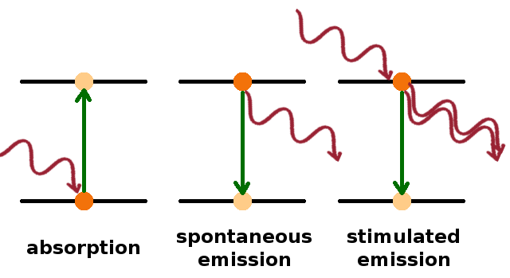


VARIOUS ATOMIC INTERACTIONS RELATED TO LASER
So the three processes can be summarized through this diagram………………
Total Probability of emission of transition from upper level 2 to the lower level 1 is given by
Or
Fig. 9 Three processes [8]

Slide 18
SUMMARY
Introduction to LASERS
Properties of Laser
Quantum Processes
Absorption
Spontaneous emission
Stimulated Emission

Slide 19
FAQS
Is the brightness of the laser light a good indicator of its power?
Why are lasers uniquely hazardous?
List advantages and disadvantages of Laser.
How LED is different from diode Laser?

Slide 20
REFERENCES
[1] http://news.mit.edu/2018/laser-attract-alien-astronomers-study-1105
[2] https://www.gutenberg.org/files/36/36-h/36-h.htm
[3] https://www.youtube.com/watch?v=_yLfLDHBUak
[4] stockphoto.com/in/vector/abstract-red-laser-beam-transparent-isolated-on-black-background-vector-illustration-gm1048453908-280444377
[5] https://www.physics-and-radio-electronics.com/blog/absorption-of-radiation-spontaneous-emission-and-stimulated-emission/
[6] https://www.convergentlaser.com/laser-safety
[7] https://skullsinthestars.com/2008/09/03/optics-basics-coherence/
[8] https://users.aber.ac.uk/ruw/teach/327/spec.php
[9] Laud B.B., Laser and Non -Linear Optics, Edition 1st, (1991), Wiley Eastern Ltd.
[10] Beiser A, Concepts of Modern Physics,Edition 6th, (2003),Tata Mcgraw Hill, Noida.
[11] Bhattacharya D. K., Tandon Poonam, Engineering Physics.,Edition 1st , (2015), Oxford.
[12] Ghatak A. (2012) Optics, McGraw Hill Education. ISBN: 978-1259004346.

Slide 21
THANK YOU
anukapoor.appsci@cumail.in

